Slide 1

SMARTER Reconciliation and anomaly detection
Hackathon 03/26/2025
EXPLORERS
Biswajit Mishra
Eajjyaz Ahmed
Ashok Sivayogi
Praveen R

Slide 2
Introduction
Detect Anomalies by comparing real-time data against historical data
Build a classification system to identify reason for anomalies
Use of Agentic AI to resolve reconciliation breaks

Slide 3
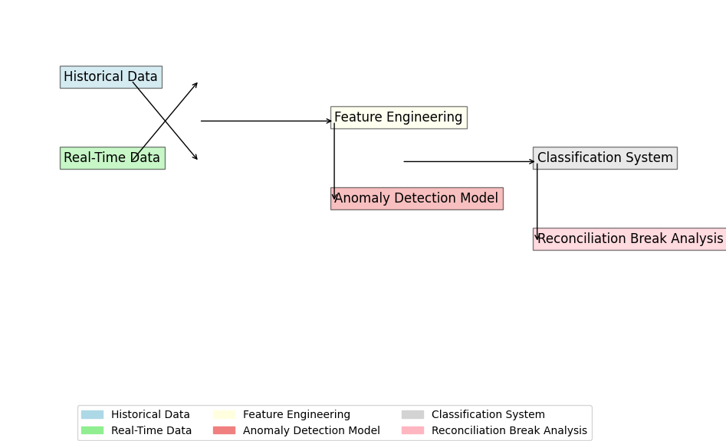
Explanation
Historical Data & Real-Time Data: Inputs for anomaly detection.
Feature Engineering: Extract meaningful features for analysis.
Anomaly Detection Model: Identifies unusual patterns using machine learning.
Classification System: Categorizes anomalies based on predefined rules.
Reconciliation Break Analysis: Uses Agentic AI to resolve discrepancies

Slide 4
Approaches
Data Processing: Normalize and clean historical and real-time data.
Feature Engineering: Extract temporal features (e.g., day of week, month-end flags).
Anomaly Detection Model: Use Isolation Forest for unsupervised anomaly detection.
Classification Logic: Rule-based classification to identify reasons for anomalies.
Agentic AI Integration: Automates reconciliation break resolutions.
Detection Performance achieved using Isolation forest which is improvement over traditional methods.
Classification accuracy successfully identifies anomaly types with high accuracy.
Reconciliation Insights using agentic Ai resolves discrepancies faster, reducing manual effort and improving overall efficiency.

Slide 5
Thank you

